Slide 1
EleNa: Elevation Based Navigation
By Group Kashikoi
Members: Astha Baranwal, Divya Sharma, Kavya Harlalka, Rohan Acharya
Github: https://github.com/kavyaharlalka/kashikoi-elena-navigation

Slide 2
The Problem
Navigation Systems typically provide the shortest path between any two given points. These are not optimal for a lot of scenarios where the user is interested in finding a path which has the least elevation gain. Moreover, some users might be interested in finding a path which has elevation gain so that they can partake in an intense and time-constrained workout. To extend navigation systems to solve the above problems, we have designed a software system that takes two points as input and finds the optimal route between them that maximizes or minimizes elevation gain while limiting the total path distance to n% of the shortest path between these two points.
Notes:
The user can also decide the maximum percentage of the shortest route that they would like to take. For example, the user can set the maximum length of the path to be 150% of the shortest path.

Slide 3
The Problem
Stakeholders Runners, bikers, hikers, tourists, fitness enthusiasts, event organizers, researchers, rescue teams.
Non Functional Requirements
Understandability, Readability, Testability, Reliability, Compatibility, Modularity, Extensibility and Usability
Functional Requirements
Map which renders the optimal route for the set of inputs sent by user, apply 5 algorithms, check and validate the inputs, ensure accuracy and performance of the algorithm is optimal etc.

Slide 4
User Stories
As the user, I want to consider the elevation gain while planning a route between two locations.
As the user, I want to select a location from dropdown.
As the user, I want to be able to choose minimize or maximize elevation gain.
As the user, I want to be able to limit the path to n% of the shortest path between two points.
As the user, I want to be able to choose which algorithm should be used.
As the user, I want to be able to choose which transportation mode I prefer.
As the user, I want the optimal route to be visible on the map.
As the user, I want the distance and elevation gain information for the optimal route to be visible.

Slide 5
The Design
We built a fully functional system focusing on developing and experimenting with six routing algorithms for computing the route.
Architecture: Model View Controller (MVC)
Tech Stack:
Python Flask for backend
HTML, CSS, Javascript for frontend
Google Maps API to display the final route to the user
OpenStreetMap API to access the geographic database
SQLite for storing navigation history

Slide 6
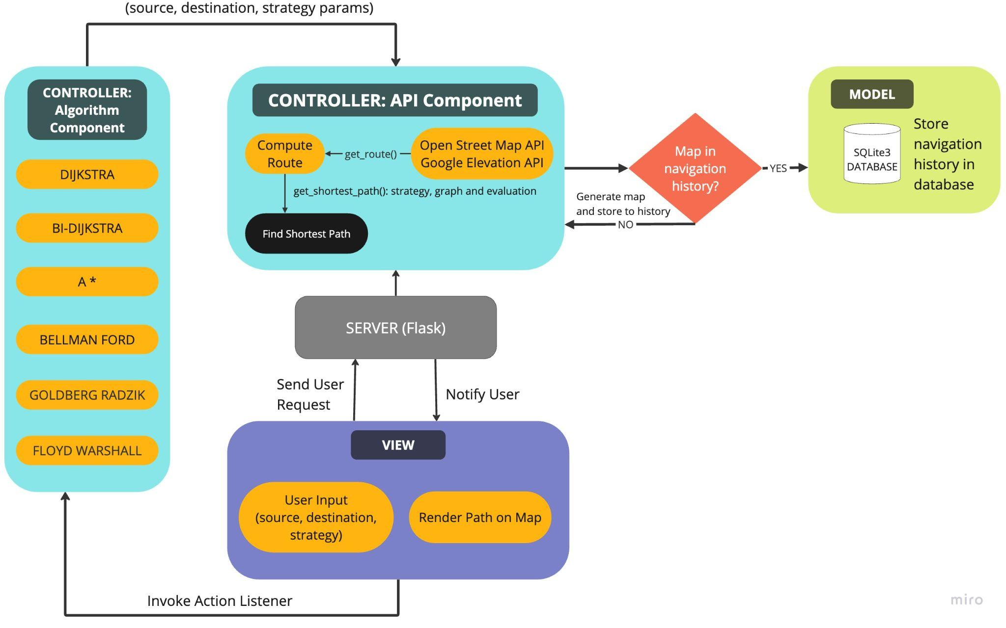
ARCHITECTURE

Slide 7
ARCHITECTURE
View will take the input:
Origin and Destination location
Strategy corresponding to the minimum or maximum elevation
One of the two algorithms (Dijkstra/A*)
Path limit (Maximum percentage of the shortest path)
Controller will call OpenStreetAPI to generate the graph and GoogleMaps Elevation API to populate the nodes with elevation attributes.
Controller will send the coordinates and strategy to Model.
Model will store the coordinates and strategy in history.
Finally, Controller notifies the view to display the computed path.

Slide 8

FRONTEND

Slide 9
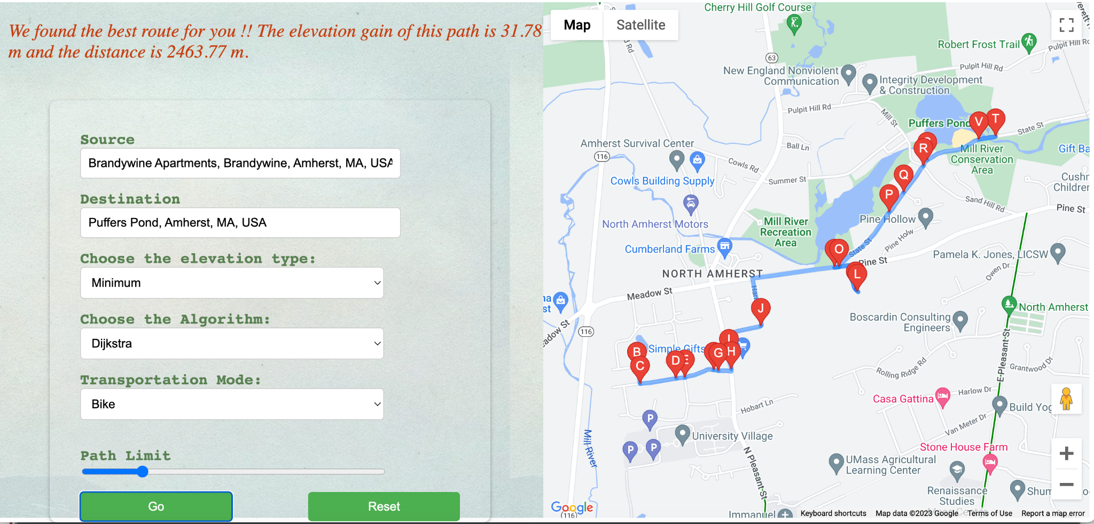
FRONTEND

Slide 10

Demo: Code Walkthrough
We have created an independent API that can be used externally by other users as well for their own applications.
This API is capable of finding the best and shortest routes and responds with their details.
We will now walkthrough the code and show the key components of the Controller and Model.
Then we will use Postman to demonstrate a request sent to our API and its response.

Slide 11
The Evaluation
We have done testing to to ensure that all the functions and modules are tested and all corner cases are covered:
UI Test
Manual Test
Performance Test
Unit Test
Integration/API Test
We achieved a test coverage of 100% (evaluated using pytest-cov)

Slide 12
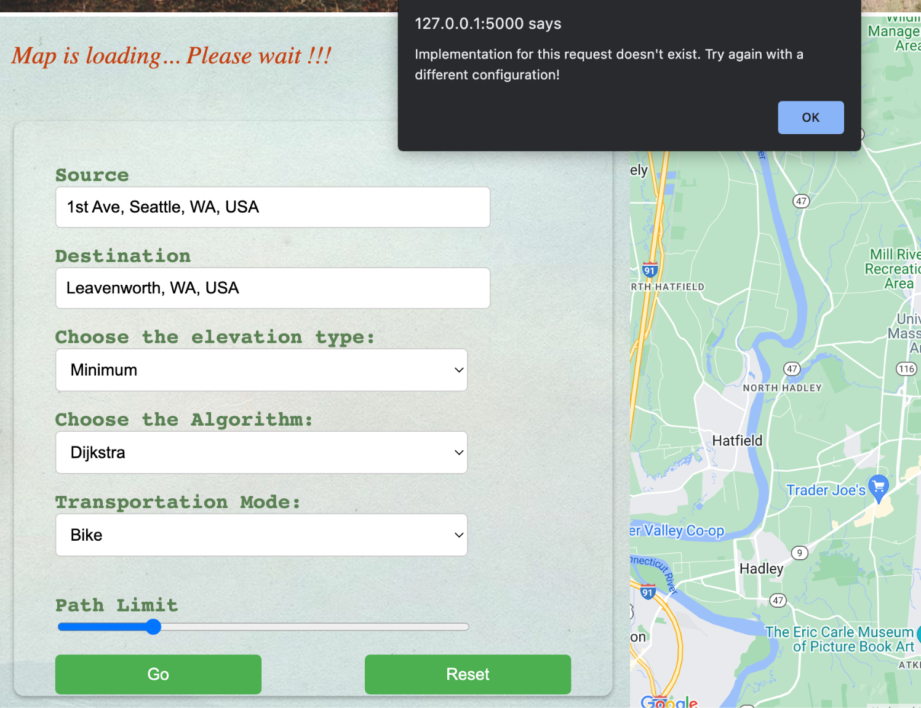
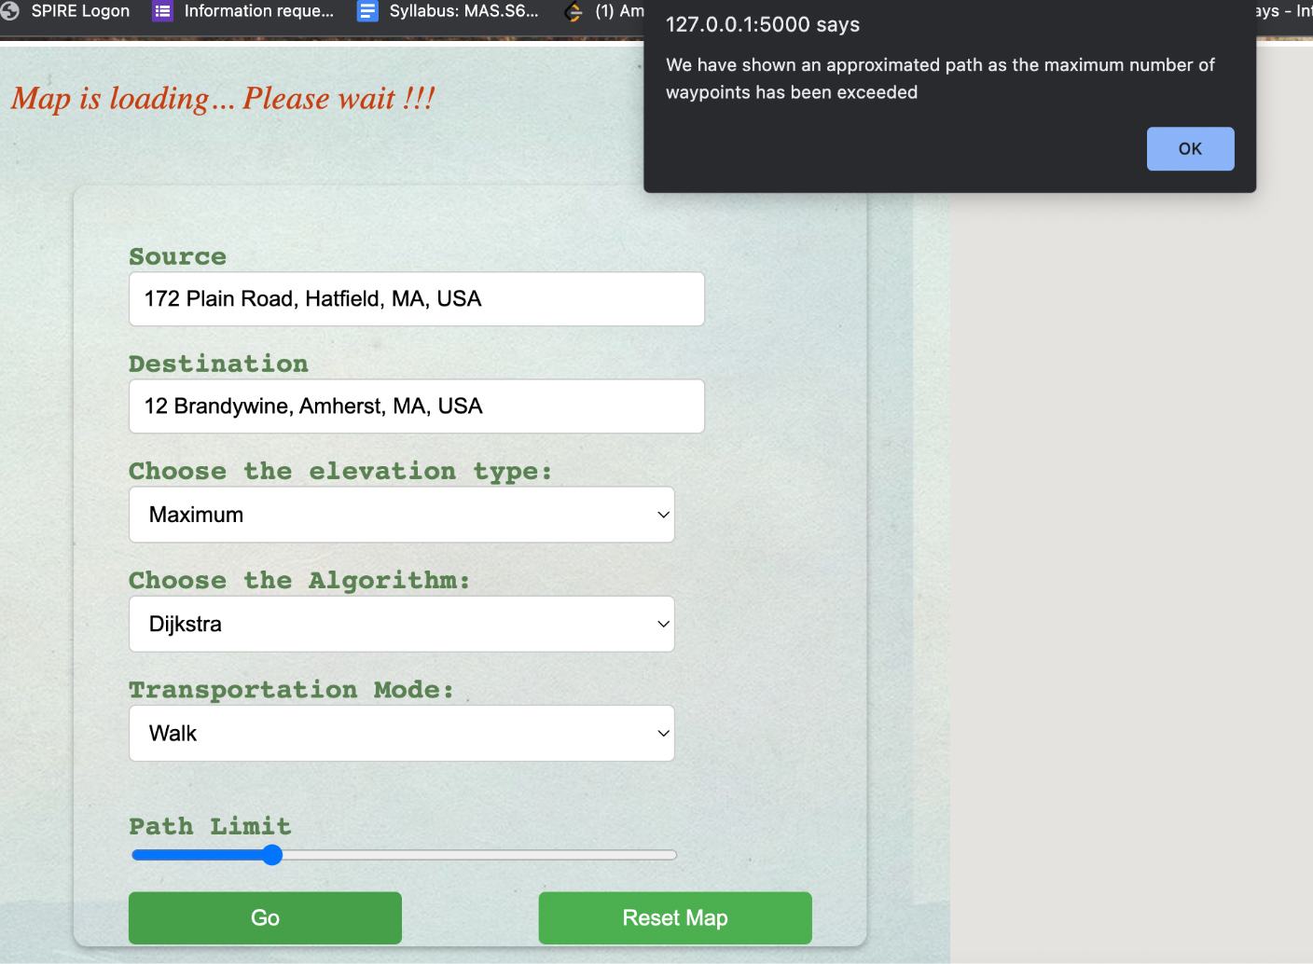
UI TEST example
MANUAL TEST example

Slide 13
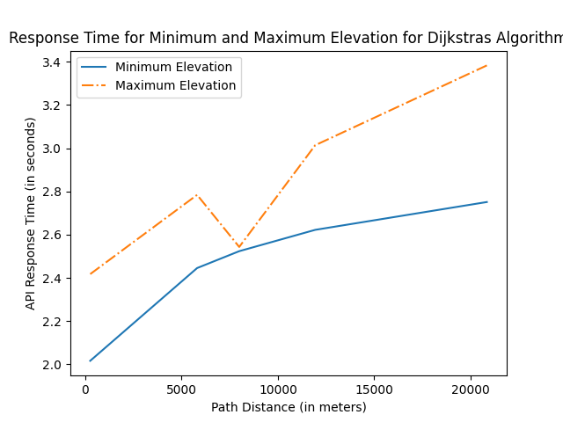
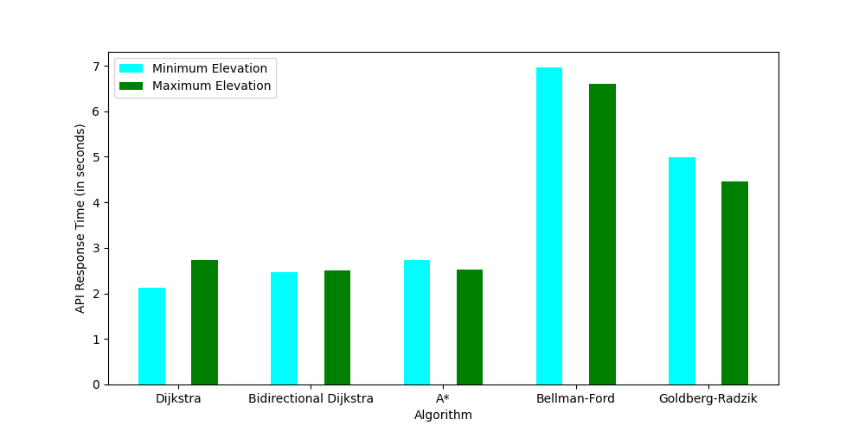
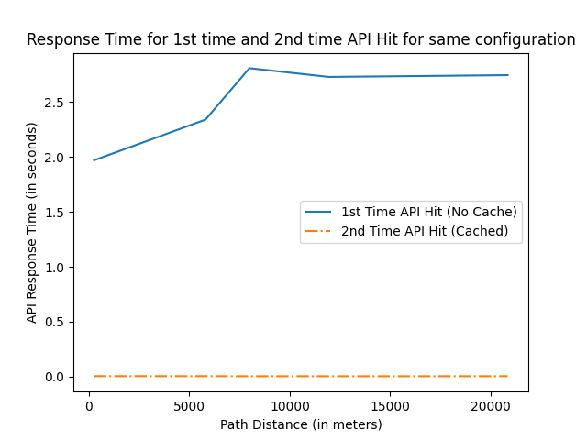
Performance test results

Slide 14
UNIT TEST
INTEGRATION TEST
Testing with invalid values to ensure error is thrown
Testing the sql db manager methods to:
ensure that insertion and fetch are working
throw data check errors in case of invalid data
Illegal Source Address
Illegal Destination Address
Null Source Address
Null Destination Address
Illegal Algorithm ID
Illegal Path Percentage
Illegal Transportation Mode

Slide 15
CONTRIBUTIONS
Group Member Responsibilities
We implemented the entire application using pair programming.
Frontend: Map component - Divya, Rohan Input component - Divya, Rohan Backend: Algorithms - Kavya, Astha All other components - Kavya, Astha
Test suites: Everyone
Documentation: Everyone

Slide 16
THANK YOU!

